Slide 1

WebQuest to
St. Patrick’s Day
Kiria Cruz •Educ 570 • University of Saint Josepth • Prof. Arroyo

Slide 2

WebQuest to St. Patrick’s Day
Objective:
After the lesson, students will be able to have a cultural understanding about St. Patrick’s Day and why it is celebrated in the United States.
Class type:
Heterogeneous ESL Class
Low beginners to Low Intermediate

Slide 3

WebQuest to St. Patrick’s Day
Materials, Media, Resources:
Computers/Chromebooks/Cellphones with Internet/wi-fi connection
A set of headphones
(provided by teacher if they do not have their own)
St. Patrick’s Day WebQuest (from TalkTech570 Website)
Google form ( assessment embedded on the webQuest) http://goo.gl/forms/JZe6kKvfD2

Slide 4
Procedure
Initial question
Why do you think that we need to learn about North American culture?
Inquiry Chart about St. Patrick’s Day
    An Inquiry chart is a beGlad strategy that asks what do they know about certain topic and what they would like to know.

Slide 5
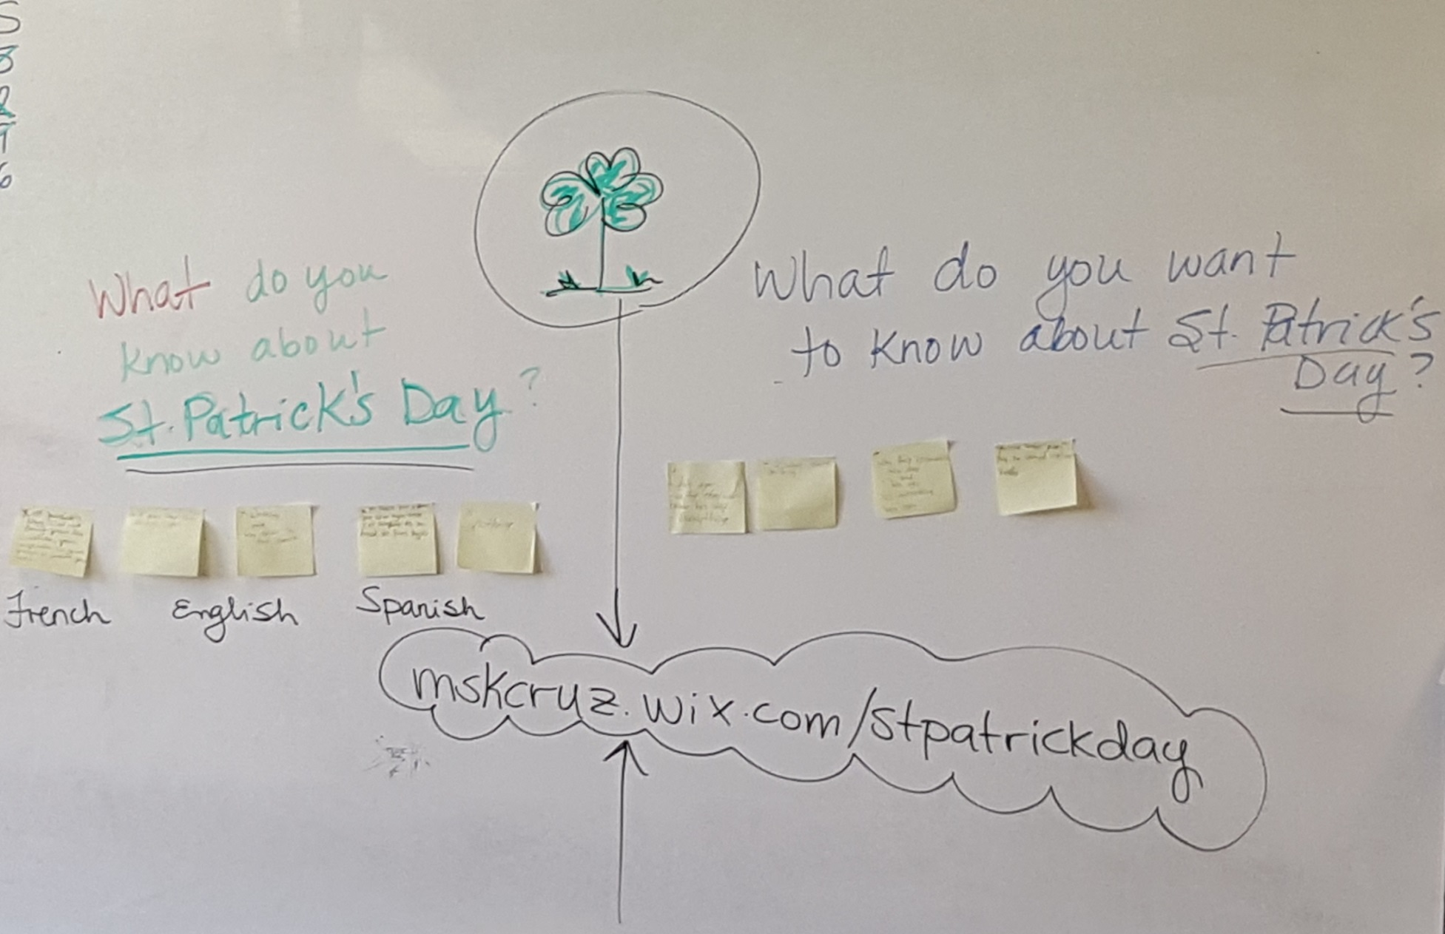
Inquiry Chart

Slide 6
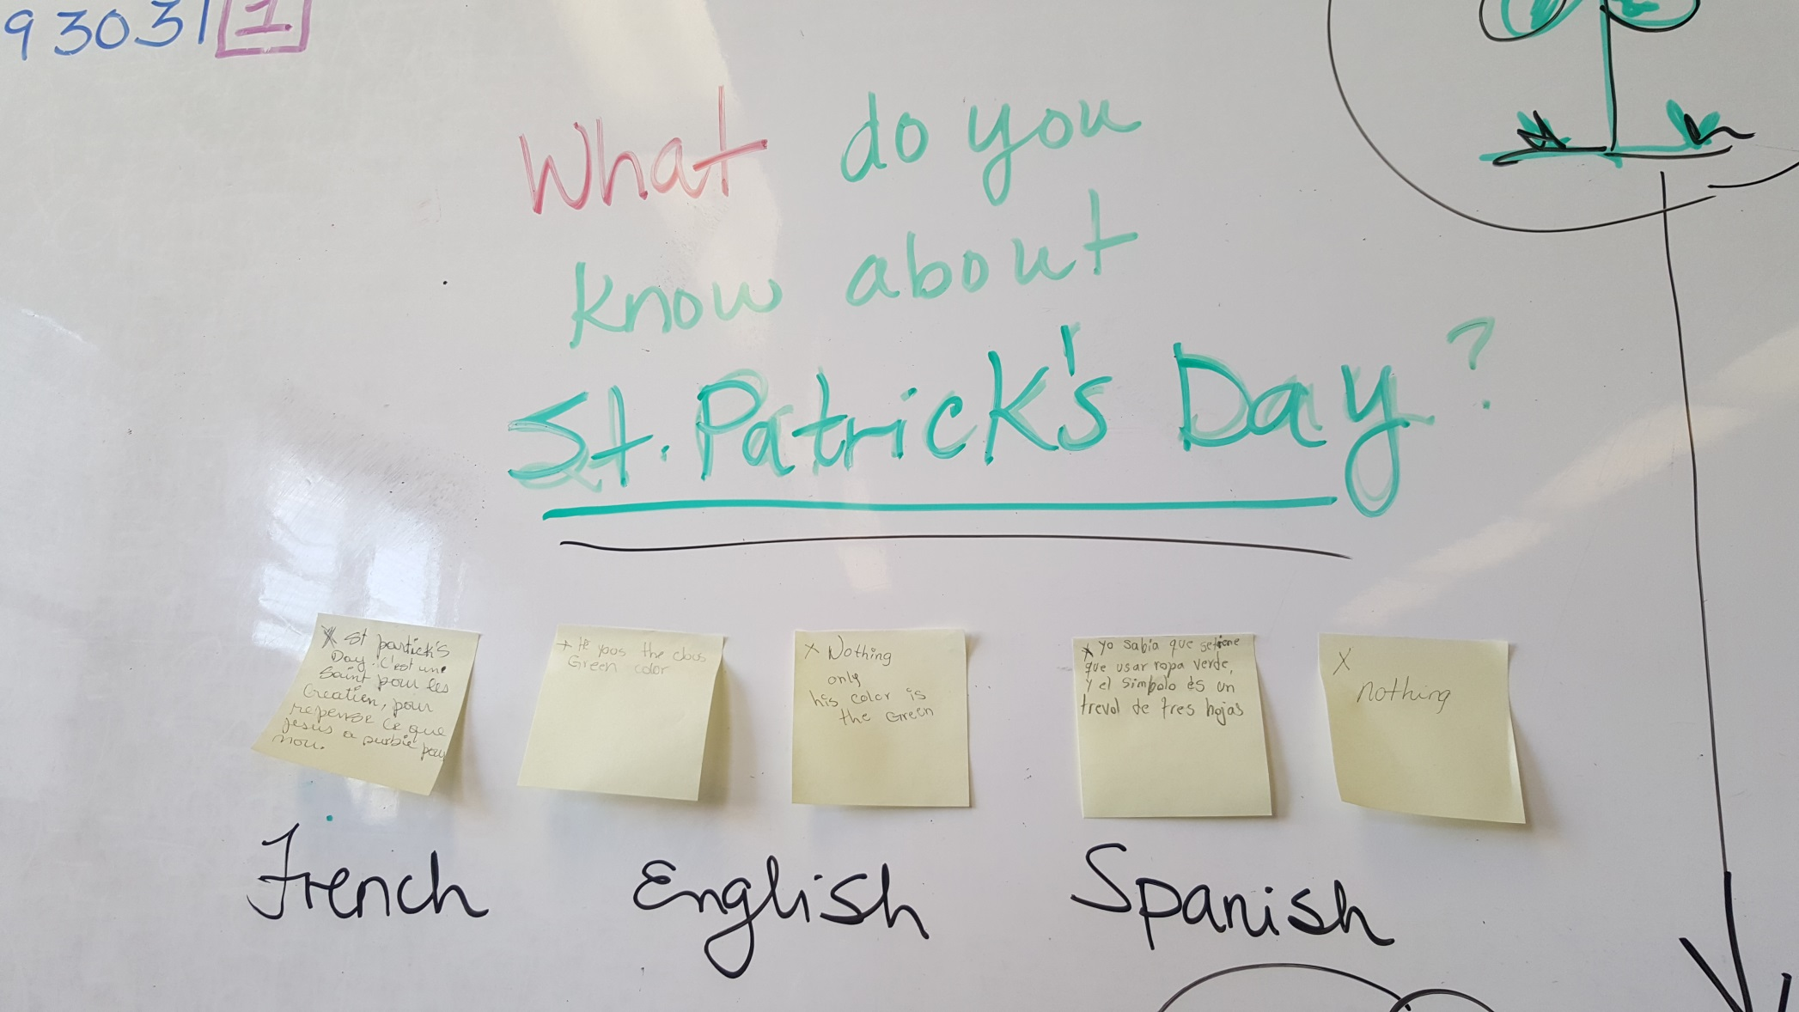
Inquiry Chart

Slide 7
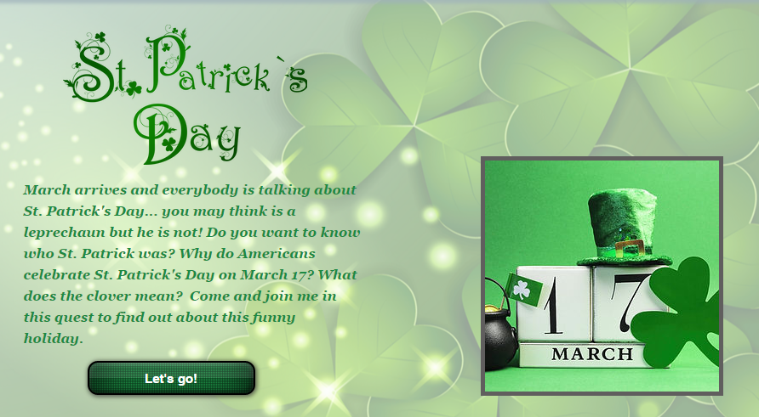
Procedure
WebQuest http://mskcruz.wix.com/talktech570

Slide 8
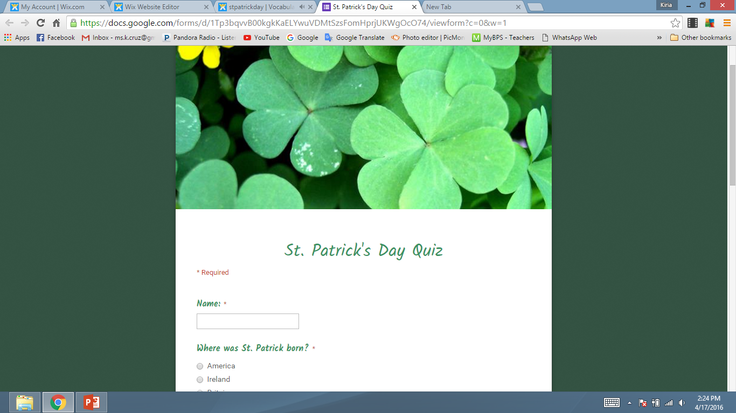
Procedure
After the students traveled through the WebQuest and completed the assessment (Google Forms), both students and teacher will summarize the story.

Slide 9

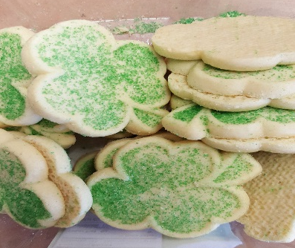

Closure
Students will express which legends they believe are true and which ones they find difficult to believe. They will share which parts of the WebQuest they enjoyed the most.
The assessment will be discussed
Students will be encouraged to fill out the survey.
During the last 5 minutes of the class, students will enjoy a shamrock shaped cookie.
100% (1 student) | 83% (5 students) | 67% (4 students) | 50% (1 student)

Slide 10
